Slide 1
ChibiOS/RT Architecture
A free embedded RTOS
http://www.chibios.org

Slide 2
Concepts
Static design
  Everything in the kernel is static, nowhere memory is allocated or freed
  Allocator subsystems are optionally available, built as a layer on top of the fully static kernel
No error conditions
  System APIs have no error conditions
  All the static core APIs always succeed if correct parameters are passed
Simple, fast and compact
  Each API function should have the parameters you would expect
  Note, first “fast” then “compact”
Portable
  Efficient layered architecture
  Non portable parts are small and enclosed in well defined layers

Slide 3
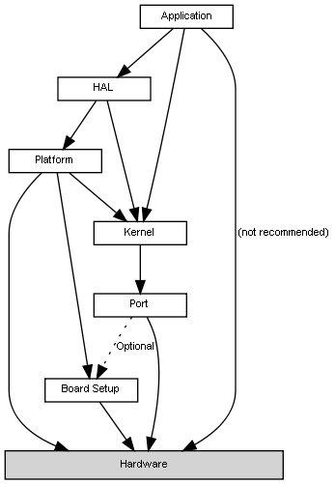
General Architecture
Application
  High level application code abstracted from hardware details
HAL
  High level, cross platform, drivers API layer
Kernel
  Portable RTOS kernel layer
Platform
  Low level, platform-specific, drivers layer
Port
  Kernel port layer for a specific Architecture
Board
  Board-specific description and initialization code
Hardware
  The HW platform

Slide 4

Kernel Architecture #1
System Interface module
  Initialization, ISRs abstraction, interrupts abstraction, context switching
Basic Scheduler module
  Threads states transitions, scheduling strategy, centralized timeout
Threading module
  Threads creation, termination, delay, synchronization
Virtual Timers module
  Unlimited Virtual Timers using a single physical timer used also for system tick
  System time handling

Slide 5
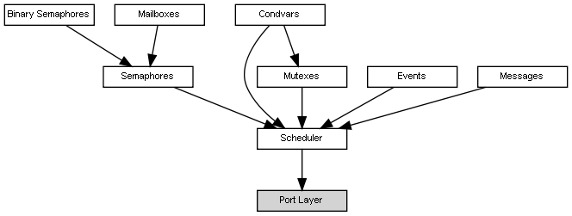
Kernel Architecture #2
Semaphores
  Both counter and binary variants supported
Mailboxes
  Thread to thread, ISR to thread, thread to ISR
Mutexes and Condition Variables
  Multilevel Priority Inheritance algorithm
  Inspired by Posix mutexes mechanism
Event Flags
  Allow to wait for a single event or multiple events
Messages
  Fast context switch allows for efficient in-system client/server software architectures
I/O Queues
  Dedicated to communications between ISRs and Threads
Abstract Streams Interface

Slide 6
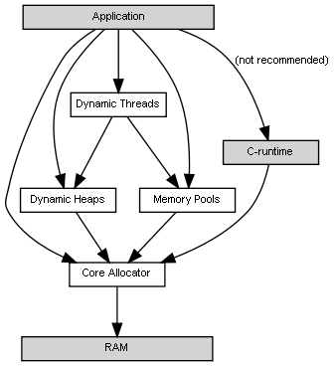
Kernel Architecture #3
Three optional Allocators
  Core Allocator (allocation only)
  Heap Allocator (classic alloc() and free())
  Pools Allocator (pools of fixed size objects)
C-Runtime Allocator support
Unified Memory Layout
  All allocators feed from the core allocator
Dynamic Threading
  Support for dynamic threads creation and termination
  Thread pools

Slide 7
Kernel Function Names
Function/macro names follow a rigid convention:
ch denotes a kernel APIs
<SUB> is the kernel subsystem, for example Thd, Sem, Mtx etc
<NAME> is the function name, there are conventions about names to keep the set consistent, for example:
  “Init” denotes an object initialization function, the function can be used before the kernel is initialized , for example chSemInit()
  “Start<something>” starts and asynchronous activity that continues in background, for example chThdStartStatic()
<CLASS> is the optional class that defines the API use context:
  “none” is a normal function that has to be called from thread coontex
  “S” is a function that must be called from within a critical zone and can reschedule internally
  “I” is a function that must be called from within a critical zone and does not reschedule internally
  “FromIsr” is a function meant to be called from ISRs only
ch<SUB><NAME>[<CLASS>]()

Slide 8
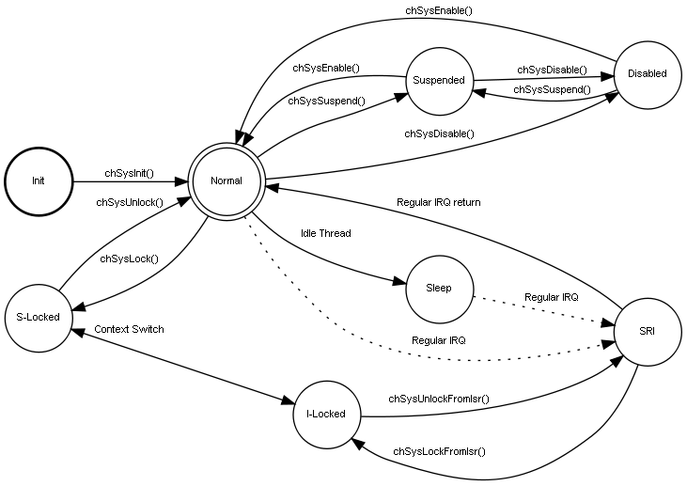
System States #1
The system state defines which function classes can be called in a given context

Slide 9

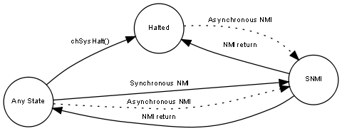
System States #2
Some state transitions are always possible
Fast IRQs can always preempt the kernel
NMIs can always preempt anything

Slide 10
System States #3
“I-Class” APIs can be called in the S-Locked or I-Locked states only
“S-Class” APIs can be called in the S-Locked state only
Normal APIs can be called from the Normal state only
Initialization functions can be called in any context
NMIs and Fast Interrupts can use “delegate ISRs” in order to use Kernel services
The System State Checker debug option makes sure that the functions are called in the correct context

Slide 11
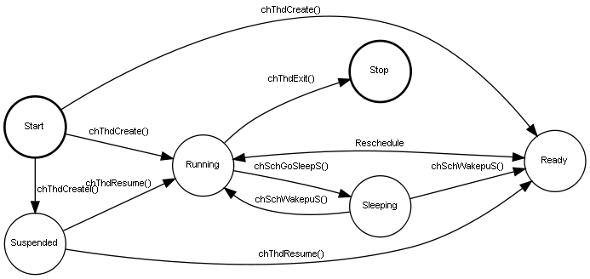
Thread States
Threads have several possible states
  Suspended
  Running
  Ready
  Sleeping
  Terminated

Slide 12
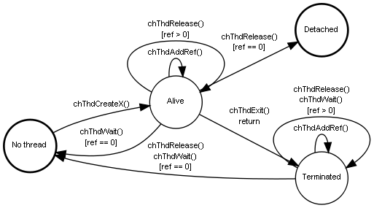
Threads Life Cycle
Static threads do not have a life cycle
Dynamic threads must be handled
  Threads have one or more owners that can wait and recover memory, a reference counter is part of the Thread structure
  Detached thread have no owners, memory can be recovered using the Registry mechanism

Slide 13
Priority Inheritance
ChibiOS/RT supports a “Multi Level Priority Inheritance” algorithm
  The example is taken from the ChibiOS/RT test suite where there is a specific test case testing this specific situation
  Low priority thread 0 is the “resource holder”
  Medium priority thread 1 is the thread preempting thread 0 with a CPU-intensive job
  High priority thread 2 is the thread blocked by the lower priority thread 1, the Priority Inheritance algorithm makes sure that thread 0 acquires temporarily the same priority of thread 2 avoiding the condition of Priority Inversion
* Time ----> 0 10 20 30 40 50 60 70 80 90 100
* 0 ......AL++++++++++............2+++++++++++AU0---------------++++++G...
* 1 ..................++++++++++++------------------++++++++++++G.........
* 2 .............................AL..........++++++AUG...................
* ^ ^
* Legend:
* 0..2 - Priority levels
* +++ - Running
* --- - Ready
* ... - Waiting or Terminated
* xL - Lock operation on mutex 'x'
* xUn - Unlock operation on mutex 'x' with priority returning to level 'n'
* G - Goal
* ^ - Priority transition (boost or return).

Slide 14
ISR Abstraction
ISR are written in an architecture independent way, details are hidden to the application developer
CH_IRQ_HANDLER(irq_vector_name) {
CH_IRQ_PROLOGUE();
/* IRQ handling code, preemptable if the architecture supports it.*/
chSysLockFromIsr();
/* Invocation of some I-Class system APIs, never preemptable.*/
chSysUnlockFromIsr();
/* More IRQ handling code, again preemptable.*/
CH_IRQ_EPILOGUE();
}
CH_FAST_IRQ_HANDLER(irq_vector_name) {
/* Fast IRQ handling code, preemptable if the architecture supports it.
The invocation of any API is forbidden here because fast interrupt
handlers can preempt the kernel even within its critical zones in
order to minimize latency.*/
}

Slide 15
Abstract Streams
Abstract streams are an abstract interface for generic data streams
They make the access to streams independent from the implementation logic
No code is present, streams are just abstract interfaces
The stream interface can be used as base class for high level object types such as files, sockets, serial ports, pipes etc.
Inheritance and polymorphism made possible in C language using virtual methods tables (VMTs) and wrapping macros:
#define chSequentialStreamWrite(ip, bp, n) ((ip)->vmt->write(ip, bp, n))
#define chSequentialStreamRead(ip, bp, n) ((ip)->vmt->read(ip, bp, n))

Slide 16
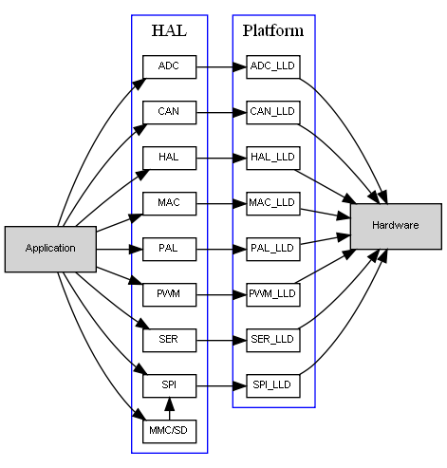
HAL Architecture #1
The HAL is responsible for MCU and board initialization
The HAL offers abstract device driver models
  Device driver are designed to not be MCU-specific, the API is generic
  The platform layer implements the device drivers for a specific MCU
  MCU-specific details are restricted into configuration structures that can be kept separated from the application core
There are three distinct classes of device driver
Device drivers are like classes that inherit from a common ancestor
  Common methods

Slide 17
Board Files
Boards are described by just three simple files
  Boards are easily added by creating 3 new files (board.h, board.c, board.mk)
    board.c , board-specific initialization code
    board.h, board clock settings, board I/O settings, on board PHY name
    board.mk, board makefile segment, very small
  A graphical configurator exists
Applications can be switched to other boards
  Just change the board name in the Makefile to retarget your application
  I/O pin names can be different
  Differences can be “encapsulated”

Slide 18
Device Driver Classes
Platform Device Drivers
  Device drivers that are specific of a platform and have a non-standard API
  Usually helpers for other driver, for example a centralized DMA manager
Normal Device Drivers
  Split in a portable High Level Driver (HLD) and a platform-specific Low Level Driver (LLD)
  Implement a generic functionality on a specific platform
Complex Device Drivers
  Drivers that are completely portable, they use other device drivers in order to communicate with hardware, for example the MMC driver uses a SPI driver as interface, the USB-CDC driver uses a USB driver
  Implement a generic functionality on any platform

Slide 19
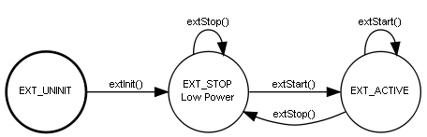
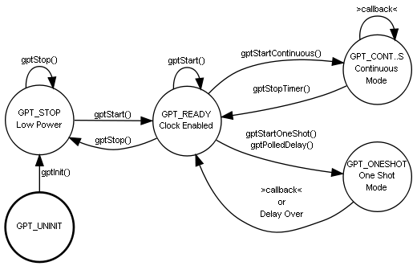
Device Drivers are State Machines
Device Drivers are described using state diagrams
API usage context and callbacks triggering are clearly described

Slide 20
Device Drivers #1
ADC
  Able to work in “streaming” mode where a buffer is continuously filled with samples from one or more channels
  Supports DMA transfers
  Able to generate callbacks at half/full buffer marks
CAN
  Allows to exchange frames among CAN devices
EXT
  Generates callbacks on input pins state transitions
GPT
  Periodic or one-shot callbacks generated by an hardware timer
  Delays

Slide 21
Device Drivers #2
I2C
  Can support DMA transfers
ICU
  Input Capture Unit
  PWM Input
  Measures Periods and Pulse Width
PWM
  Dynamically variable period and duty cycle
  Can call callbacks on pulse end and on cycle end
MAC
  Ethernet driver supporting uIP and lwIP stacks

Slide 22
Device Drivers #3
PAL
  Ports Abstraction Layer, abstracts digital I/O
  Pins reconfiguration at board initialization and at runtime
  Handles Pins, Ports or Pin Groups
RTC
  Clock Calendar with wakeup capability
SDC
  SD/MMC interface via SDIO
MMC_SPI
  SD/MMC interface via SPI
SPI
  Supports DMA transfers
  Synchronous or Asynchronous API with callback capability

Slide 23
Device Drivers #4
Serial
  Serial UART driver with circular buffers
  Able to generate kernel events on I/O events
Serial over USB
  Implements a CDC class USB device
  Same software interface of a normal Serial driver, interchangeable
UART
  Asynchronous UART driver
  Packets oriented
  Supports DMA transfers with callbacks
USB
  USB device abstraction
  Callbacks capable

Slide 24
Time Measurement Unit
Cycle-accurate time measurement
Repeated measurements
  Able to report worst-best-last measurements
Cycle-accurate delays
Utility macros to convert among time units
  Cycles to microseconds, microseconds to cycles
  Cycles to milliseconds, milliseconds to cycles
  Cycles to seconds, seconds to cycles
Requires a dedicated hardware free running counter

Slide 25
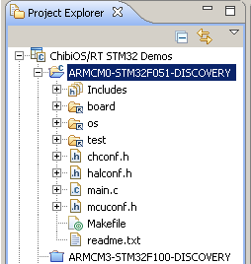
Application Organization
The standard application template
  main.c, application main
  chconf.h, kernel configuration file
    Kernel options
    Kernel hooks
  halconf.h, HAL configuration file
    Include/exclude the various device drivers
  mcuconf.h, MCU configuration file
    Setting up the various peripherals parameters
    IRQ priority
    DMA priority
    Any other HW-related setting
  Makefile, build file
All files are available as templates
Settings defaults are almost always acceptable
Always the same, learn once use anywhere

Slide 26

End of Architecture

